Slide 1

ESFP-II Project
Computer Organization Management System
BY:
Thacker Ghanshyam J
CSE(BDA)
21162121037

Slide 2
Project related topic
01
Header File
02
Class and Object
03
Switch case

Slide 3
Objective of Project :
A Computer Organization Management system is a c++ programming code designed to help users understand basic concepts of computer organization and Architecture. The system has basic conversion method such as binary to decimal and more. There is also truth table of gates such AND , NOT and more.

Slide 4
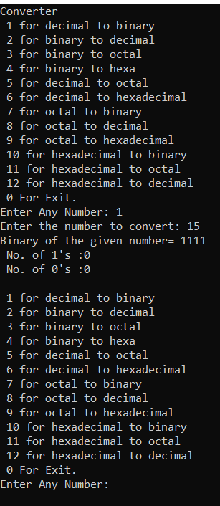
Screenshot

Slide 5
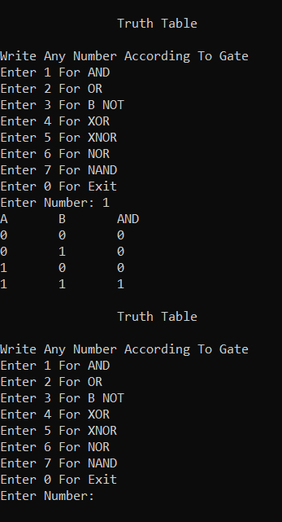
Screenshot

Slide 6
Conclusion
From this we can conclude that by C++ programming we can
get simple conversion process from binary to decimal and get
truth table of AND , OR etc. gate in one command.

Slide 7
Thank You

